Slide 1

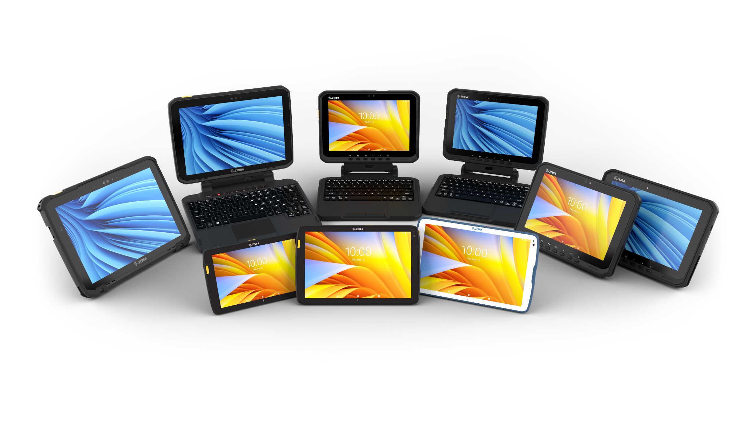
Rugged Tablets Portfolio Overview
Extremely Tough. Exceptionally Tailored.

Slide 2












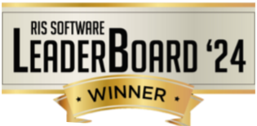
Why Zebra
Extensive Reach
Scalable to meet any
enterprise demands
Leader Status
Gartner Magic Quadrant for Indoor Location Services—Global
Our People
Make the Difference
Channel
Accolades
$4.58B
Global sales
#1
120
Offices globally
Rugged
Mobile Computing
~6.8K Patents and
patent applications worldwide
Data Capture
9.75K+
Employees worldwide in
55 countries
Barcode Printing
10K+ Channel
Partners in over 185 countries
~11%
of sales R&D
Mobile RFID
Sources: VDC Research and Zebra analysis (f#1 market share), Gartner, Magic Quadrant for Indoor Location Services, Tim Zimmerman, Annette Zimmermann, 21 February 2023. (Leader Status)

Slide 3
As the global market leader
in rugged mobile computers, Zebra knows
Merely Rugged is
Not Enough
Notes:
There are lots of rugged tablets available. But when you’re committed to setting a higher standard, you need a tablet that’s not only rugged, but also smart.
For Zebra, toughness is just the start; the real goal is far reaching, high achieving and uniquely defined by you.

Slide 4

Zebra makes your success achievable
Tailored is Critical
Not only rugged, but also smart
and purpose-built:
Outstanding wireless capabilities
Powerful collaboration tools
Windows® or Android™
Secure, configurable, simple to deploy.
Choose your:
Durability Level
Display Size
Form Factor
OS
Processing Power
Accessories
Notes:
There are lots of rugged tablets available. But when you’re committed to a higher standard, you need a tablet that’s not only rugged, but also smart.
For Zebra, toughness is just the start.
Reimagine your workday with a purpose-built tablet that’s tailored to work your way. I doesn’t force you to adjust to its abilities.
Roam far with outstanding wireless capabilities
Capture and communicate on the go
With Windows 10 or Android, you get true rugged performance beyond the industry’s highest testing standards
Zebra innovative tablets are
highly secure
fully configurable
simple to deploy
and work how and where you do
Choose your
level of durability
display size
form factor
operating system
processing power
and accessories
Empower your workforce with the global market leader in rugged mobile computers.

Slide 5
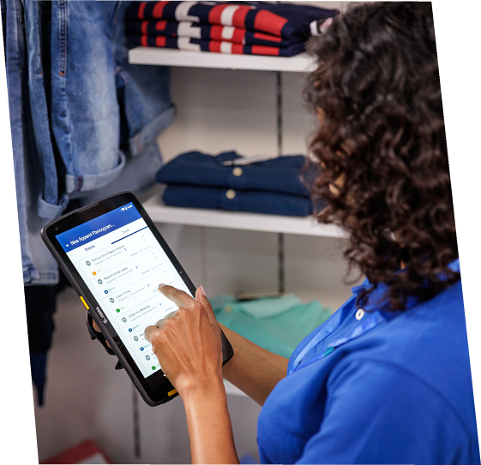
No matter the conditions…
Power Your Best Work
with Zebra
True mobility designed specifically for your environment—whether inside or outside in the harsh elements.
Transportation and Logistics
Manufacturing
Public Sector
Retail and Hospitality
Healthcare/Home Health
Warehouse/Yard/Ports
Field Mobility
Notes:
True mobility is designed specifically for your environment, applications and challenges—whether inside your own workplace or outside in the harsh elements. Zebra provides a performance edge for your industry.
Transportation and Logistics
Deliver non-stop service from the first mile to the last
Manufacturing
Ratchet up productivity from the plant floor to the front door
Public Sector
Meet mission requirements with better visibility
Retail
Delight customers from the back of the store to the sales floor
Warehouse/Yard/Ports
Manage inventory across your supply chain
Field Mobility
Empower your team wherever the job takes them

Slide 6
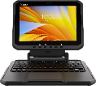
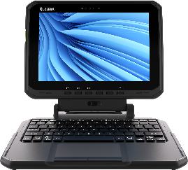
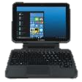






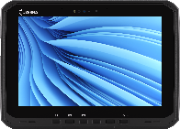

Discover Which Tablet Can Be Tailored to Fit Your Industry
 | ET40/ET45 | ET40-HC/ET45-HC | ET60/ET65 | ET60W/ET65W | ET80/ET85
Manufacturing |  |  | l | l | l
Retail and Hospitality | l
Transportation and Logistics | l |  | l | l | l
Field Mobility | l |  | l | l | l
Warehouse |  |  | l | l | l
Public Sector |  |  | l | l | l
Healthcare |  | l
All Zebra tablets can fit into virtually any vertical and use case. The above vertical market suggestions are based on Zebra's knowledge of the ideal vertical market feature sets and typical end user preferences.
Notes:
Rugged Tablet Positioning Chart
Our broad portfolio offers you a variety of options. Discover which tablet can be tailored to fit your industry and application requirements.

Slide 7
Specifications Comparison At-A-Glance
Feature | ET40/ET45 | ET40-HC/ET45-HC | ET60/ET65 | ET60W/ET65W | ET80/ET85
Dimensions | 8 in.: 8.42 in. x 5.32 in. x 0.45 in. (213.9 mm x 134.8 mm x 11.4 mm) 10 in.: 10.15 in. x 6.41 in. x 0.45 in. (257.9 mm x 162.9 mm x 11.4 mm) | 10 in.: 10.15 in. x 6.41 in. x 0.45 in. (257.9 mm x 162.9 mm x 11.4 mm) | 10.8 in. x 7.8 in. x 0.7 in. (275 mm x 199 mm x 18.3 mm) | 0.8 in. x 7.8 in. x 0.7 in. (275 mm x 199 mm x 18.3 mm) | 12.1 in. x 8.9 in. x 0.6 in. (308 mm x 225 mm x 16 mm)
Display | 8 in. (20 cm), 500 nit 10.1 in. (26 cm), 500 nit | 10.1 in. (26 cm), 500 nit | 10.1 in. (26 cm), 1000 nit | 10.1 in. (26 cm), 1000 nit | 12 in. (30.5 cm), 800 nit
Resolution | 8 in.: 1280 x 800 10 in.: 1920 x 1200 | 1920 x 1200 | 1920 x 1200 | 1920 x 1200 | 2160 x 1440
Weight (tablet only) | 8 in.: 1.07 lbs. (485 g) 10 in.: 1.52 lbs. (690 g) | 1.54 lbs. (699 g) | 2.3 lbs. (1.07 kg) | 2.6 lbs. (1.2 kg) | 2.8 lbs. (1.3 kg)
Operating System | Android |  | Android | Windows 11 Professional or Windows 11 IoT Enterprise LTSC | Windows 11 Pro, Windows 10 Pro or Windows 10 IoT Enterprise LTSC
RAM/Storage | Up to 8 GB and 128 GB UFS Flash | 4 GB and 64 GB UFS Flash | 8 GB RAM/128 GB UFS Flash | Up to 32 GB LPDDR5 RAM Up to 2 TB SSD; optional Opal SSDs | Up to 16 GB RAM and 512 GB PCIe SSD
CPU | Qualcomm® Snapdragon SM6375 |  | Qualcomm® 6490 | Intel® Core™ Ultra 5 125U Intel® Core™ Ultra 5 135U (vPro®) Intel® Core™ Ultra 7 155U Intel® Core™ Ultra 7 165U (vPro®) | Intel 11th Gen. Core i5/i7
Wireless | Wi-Fi™ 6, NFC, GPS (ET45 and ET45-HC), 5G (ET45 and ET45-HC), Private 5G/CBRS* (ET45 and ET45-HC) |  | Wi-Fi 6E, NFC, GPS (ET65), 5G (ET65), Private 5G/CBRS* (ET65) | Wi-Fi 7, NFC, GPS (ET65W), 5G (ET65W), Private 5G/CBRS* (ET65W) | Wi-Fi 6E, NFC, GPS (ET85), 4G or 5G (ET85), Private 5G/CBRS* (ET85)
AI Features | None |  | None | AI-enabled touchscreen and audio | None
* CBRS available in U.S. only

Slide 8
Specifications Comparison At-A-Glance (continued)
Feature | ET40/ET45 | ET40-HC/ET45-HC | ET60/ET65 | ET60W/ET65W | ET80/ET85
Connectors | USB-C, Docking |  | USB-C 3.1 Type C (with DisplayPort support), 2 x USB 3.1 Type A, Docking, Keyboard, Zebra eConnex | 2x Thunderbolt 4/USB 4, USB 3.1 Type A, Docking, Keyboard, Zebra eConnex, Optional Serial, Optional Ethernet | USB-C, 2x USB 3.2, Docking, Optional Serial, Optional Ethernet
Security | Software only |  | Software, Smart Card/CAC reader option​ | Facial recognition, TPM 2.0, Fingerprint reader option, Smart Card/CAC reader option, Lock slot | Facial recognition, TPM 2.0, Fingerprint reader option, CAC reader option, Lock slot
Expandability | Integrated barcode reader, 2nd battery, payments, VESA adapter, Workstation cradle and more | Integrated barcode reader, VESA adapter, Workstation cradle and more | Integrated advanced range barcode reader, RFID reader, friction hinge keyboard, rugged vehicle dock and more | Integrated advanced range barcode reader, RFID reader, friction hinge keyboard, rugged vehicle dock and more | Integrated barcode reader, friction hinge keyboard, 2nd battery and more
Drop Specification | MIL-STD-810H 4 ft. (1.2 m) drop to concrete 5.1 ft. (1.55 m) drop to concrete with rugged boot | MIL-STD-810H 3.3 ft. (1 m) drop to vinyl tile over concrete | Exceeds MIL-STD-810H​ 5 ft. (1.5 m) drop to concrete​ | Exceeds MIL-STD-810H 5 ft. (1.5 m) drop to concrete Meets MIL-STD-810H 6 ft. (1.8 m) drop to plywood over concrete | MIL-STD-810H 4 ft. (1.2 m) drop to plywood over concrete 5 ft. (1.5 m) drop to plywood over concrete with rugged boot
Sealing | IP65 |  | IP66 |  | IP65 with ports open
Freezer | No |  | Yes (heated touch screen with ET60, requires rugged vehicle dock) | No | No
Hazardous Location Cert. | No |  | C1D2 | C1D2* | C1D2 configurations available
* Available 1H 2025
For more information on Zebra Tablets, please visit www.zebra.com/tablets

Slide 9
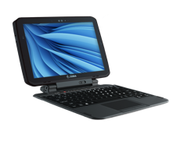




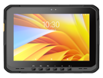



Tablet Portfolio
12"
ET8x
10"
ET4x-HC
ET6x
8"
ET4x
Right-price rugged tablets that are built for the enterprise Thinnest and lightest Zebra tablets Integrated scanner: choice of three Zebra scan engines Z-Backs: additional power and payment modules Advanced wireless communications Rugged boot option increases durability | Built for healthcare from the inside out Purpose built for healthcare Disinfectant-ready housing Thinnest and lightest Zebra tablets Integrated scanner Emergency alert button Advanced wireless communications Healthcare handstrap improves portability | The most versatile rugged business tablets Rugged for the most demanding use cases Advanced wireless communications and processors Embedded AI features provide the next evolution in the user experience* Flexible data capture options, including advanced range scanning and an optional RFID module Rugged vehicle dock for mounting in forklifts and other material handling vehicles, first responder vehicles, plus utility and delivery trucks True 2-in-1 tablet with detachable friction hinge keyboard * Windows only | Uncompromised rugged mobility True 2-in-1 tablet with detachable friction hinge keyboard Rugged, yet surprisingly thin and lightweight for a 12 in. tablet Advanced wireless communications and processor Universal docking solution – desktop and vehicle
ZEBRA CONFIDENTIAL INTERNAL USE ONLY
Notes:
Need images for devices

Slide 10




ET4x Series

Slide 11
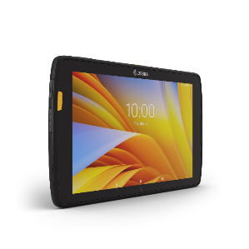
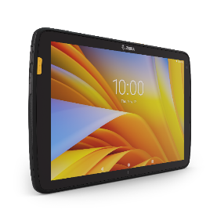
ET4x Rugged Tablets
Right Priced Tablets Built for the Enterprise
ET40/ET45 Rugged Enterprise Tablets
Android OS
Choose 8-in. or 10-in. screen
Fast wireless connectivity; ET40: Wi-Fi 6 and ET45: Wi-Fi 6 and 5G
Thin and light consumer styling, yet rugged to withstand drops, bangs, bumps, dust and water
Integrated enterprise-class scanning
Retail-ready with point of sale (POS) and mobile payment options
Most affordable Zebra tablet

Slide 12
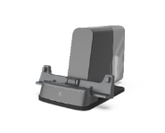
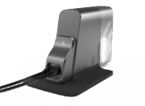

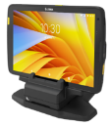
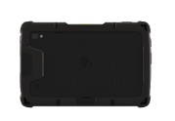
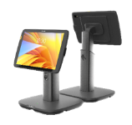
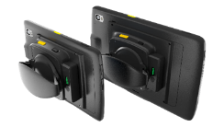
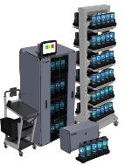
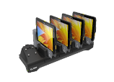

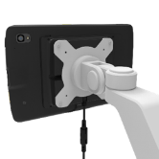
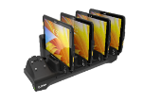

Accessories
Customize Your ET4x Tablet To Meet Your Needs
Workflow options
Carrying/Protective options
Charging/Power options
Workstation Cradle
Fixed/Hybrid Point of Sale
Rugged Boot
Single-Slot Charge Only Cradle
Presentation Stand
Expansion Back with Secondary Battery
Shoulder Straps and D-Clips
Multi-Slot Charge Only Cradle
Intelligent Cabinets,
Racks and Mobile Carts
VESA Mount Adapter

Slide 13
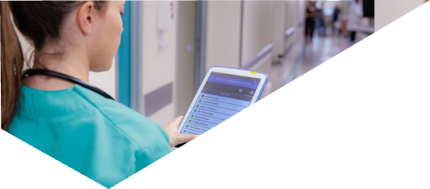

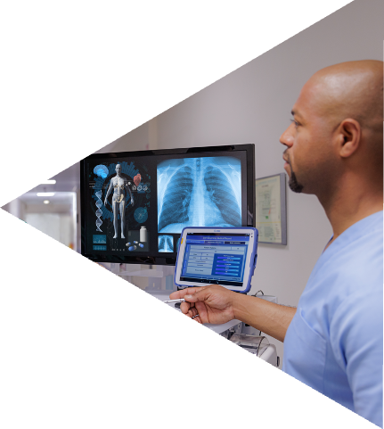
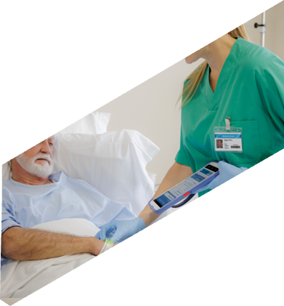
ET4x-HC Series

Slide 14
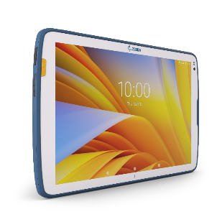
ET4x Healthcare Tablets
Built for Healthcare from the Inside Out
ET40-HC/ET45-HC Rugged Healthcare Tablets
Android OS
10-in. screen
Advanced medical grade disinfectant ready plastics
Thin and light consumer styling, yet rugged to withstand drops, bangs, bumps, dust and water
Integrated enterprise-class scanning
Programmable emergency alert button
Fast wireless connectivity; ET40-HC: Wi-Fi 6 and ET45-HC: Wi-Fi 6 and 5G

Slide 15

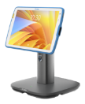
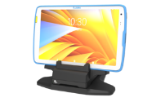
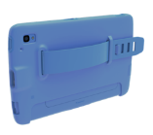
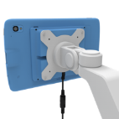
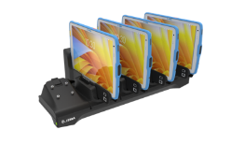
Accessories
Customize Your ET4x HC Tablet To Meet Your Needs
Workflow options
Carrying/Protective options
Charging/Power options
Workstation Cradle
Presentation Stand
Single-Slot Charge Only Cradle
Healthcare
Hand strap
VESA Mount Adapter
Multi-Slot Charge Only Cradle
Intelligent Cabinets,
Racks and Mobile Carts
Notes:
Accessories can be shared across all Zebra L10 tablet models and are fully compatible with future-generation L10 rugged tablets. No matter the application or use case, we have the accessories to help your workers do it with ease.

Slide 16



ET6x Series

Slide 17
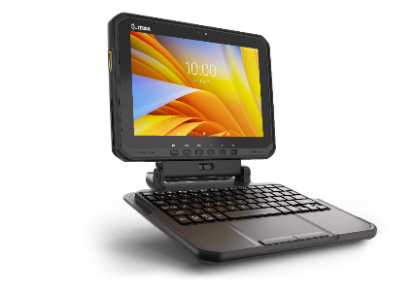
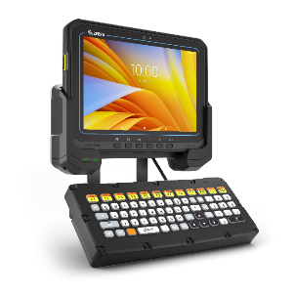
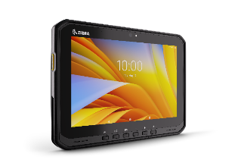
ET6x Rugged Tablets
Most Versatile Rugged Android Tablets
ET60/ET65 Rugged Enterprise Tablets:
Android OS
10-in. screen
Rugged for the most demanding use cases
ET60 Freezer version for condensing environments
Versatile form factors: tablet, 2-in-1, vehicle mount computer
Fast wireless connectivity; ET60: Wi-Fi 6E and ET65: Wi-Fi 6E and 5G
Optional integrated advanced range scanning

Slide 18
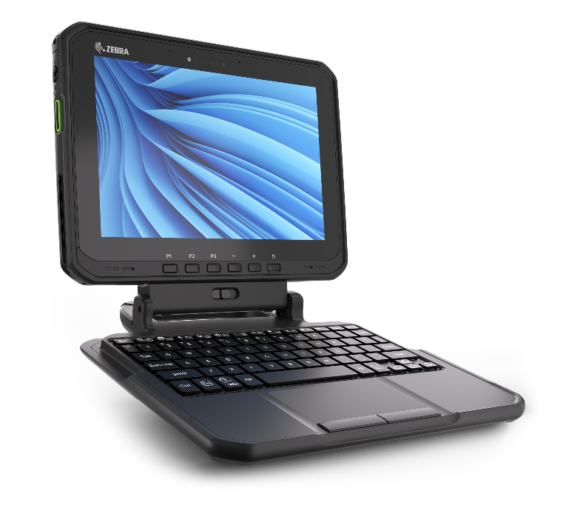
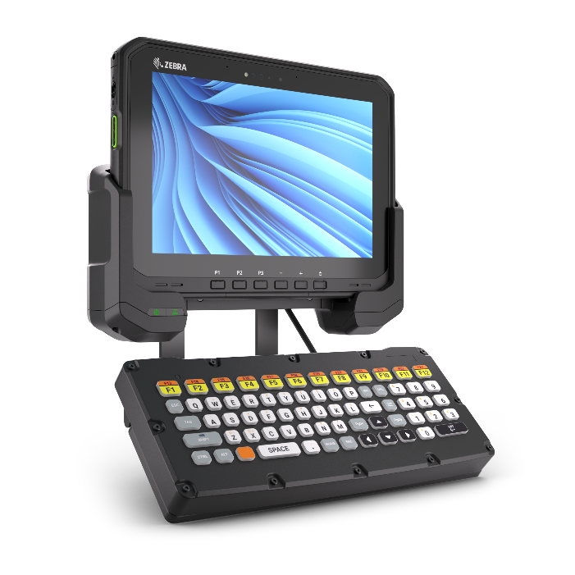
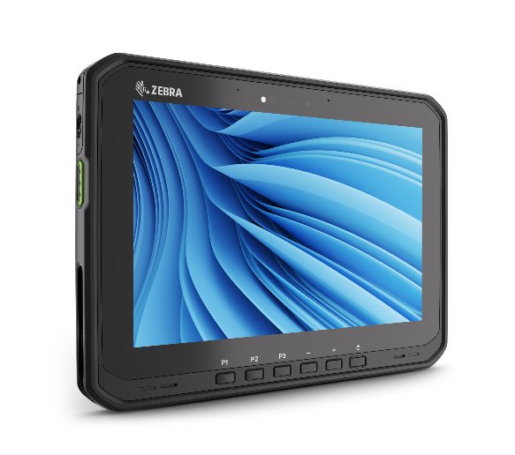
ET6xW Rugged Tablets
AI-Driven Rugged Windows Tablets
ET60W/ET65W Rugged Enterprise Tablets:
Windows OS
10-in. screen
Embedded AI-powered touchscreen and audio
AI-ready high performing processor
Rugged for the most demanding use cases
Versatile form factors: tablet, 2-in-1, vehicle mount computer
Fastest wireless connectivity; ET60W: Wi-Fi 7 and ET65W: Wi-Fi 7 and 5G
Optional integrated advanced range scanning

Slide 19

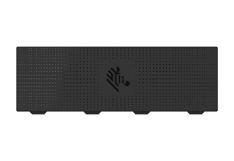
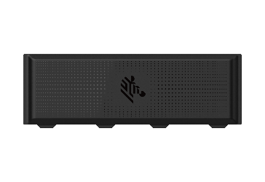



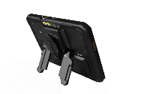

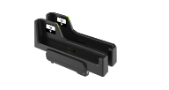

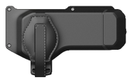
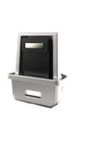
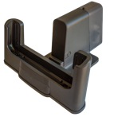

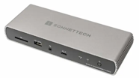
Accessories
Customize Your ET6x Series Tablet to Meet Your Needs
Workflow options
Carrying/Protective options
Charging/Power options
Friction Hinge Keyboard
Warehouse Keyboard
RFID Reader
(Expansion Back)
Carry Handle
Standard Battery
Extended Battery
Shoulder Strap
Vehicle Dock
Smart Card/CAC Reader
(Expansion Back)
Kick Stand
(Expansion Back)
Dummy Battery
(for No Battery configurations)
Two-slot Battery Charger
Attachment Clips for Straps
Connect Cradle
for Workstation Connect²
3rd Party Thunderbolt Port Replicator¹
Intelligent Cabinets, Racks and Mobile Carts
1 Windows Only
2 Android Only

Slide 20
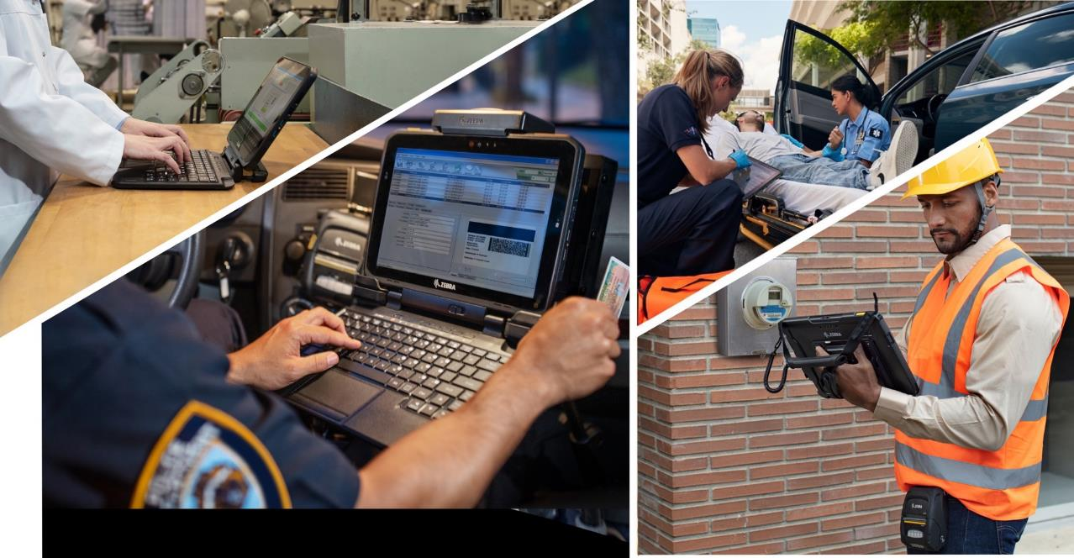
ET8x Series

Slide 21
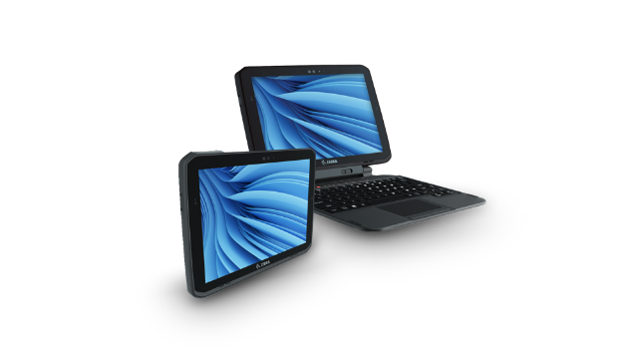
ET8x Rugged Tablets
Made for the Difference You Make
ET80/ET85 Rugged Enterprise Tablets:
Windows OS
12-in. screen
2-in-1 form factor: standalone tablet or laptop alternative with friction hinge keyboard
Rugged, yet thinner and lighter than major 2-in-1 competitors
Fast wireless connectivity; ET80: Wi-Fi 6E and ET85: Wi-Fi 6E and 5G
Universal docking solution for in vehicle and desktop
Optional integrated scanning

Slide 22
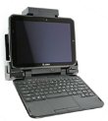














Accessories
Customize Your ET8x Tablet To Meet Your Needs
Workflow options
Carrying/Protective options
Charging/Power options
Common Dock
Vehicle
Office
Forklift
Expansion back
Rotating hand strap
Aux battery Slot
Friction Hinge
Rugged Keyboard
Handle with stylus holder
Rugged Boot
with Attach Points for Straps / Handles
Auxiliary Battery
Internal Battery
Ethernet/ Serial: Tool-less Thumb-Screw Attach Option
AC Adapter USB-C
AC cord sold separately
Expansion back Kickstand
Can be added to ET80 / ET85 expansion back
Stylus Tether
Shoulder Strap
4-Slot Battery Charger
Intelligent Cabinets, Racks and Mobile Carts
Ethernet: Tool-less Thumb-Screw Attach Option
Stylus MPP 2.0
Expansion Back - CAC
Aux battery slot
Optional Kickstand sold separately
ZEBRA TECHNOLOGIES

Slide 23
True mobility designed specifically for your environment, applications and challenges
Industries

Slide 24
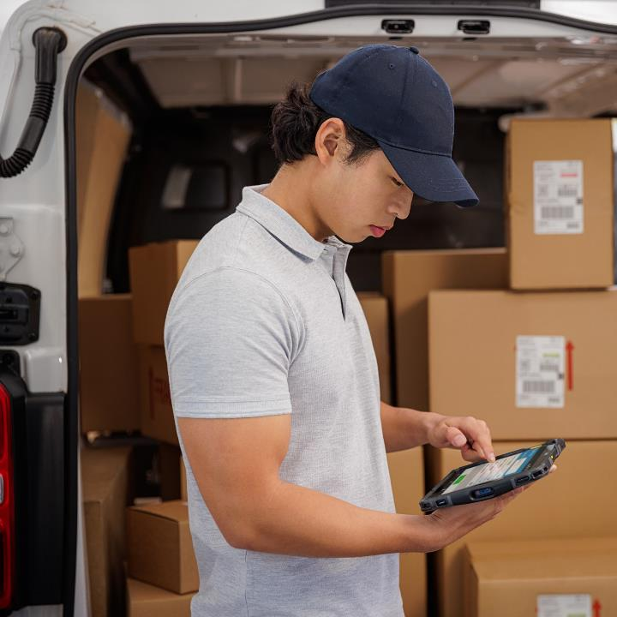
Transportation & Logistics
Deliver non-stop service from the
first mile to the last
Track and trace
Routing and dispatch
Quality Assurance
Proof of pickup
Proof of delivery
Fleet management
Inventory management

Slide 25
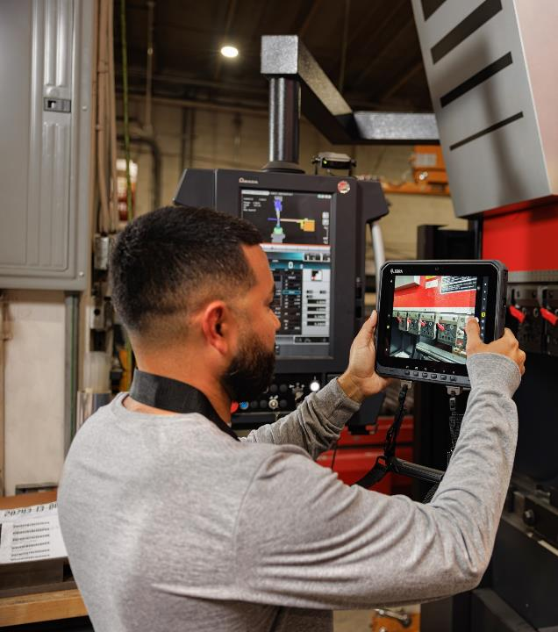
Manufacturing
Ratchet up productivity from
plant floor to front door
Inventory management
Supply-line replenishment
Safety testing
Maintenance repair and overhaul
Compliance verification
Specialized (clean room, pharma, etc.)
Plant floor management
Mobile HMI

Slide 26

Public Safety
Meet mission-critical requirements
with better visibility
Routing and dispatch
Personnel tracking
Incident reporting
E-Citation
Mobile incident command
Inventory management
Patient care reporting

Slide 27
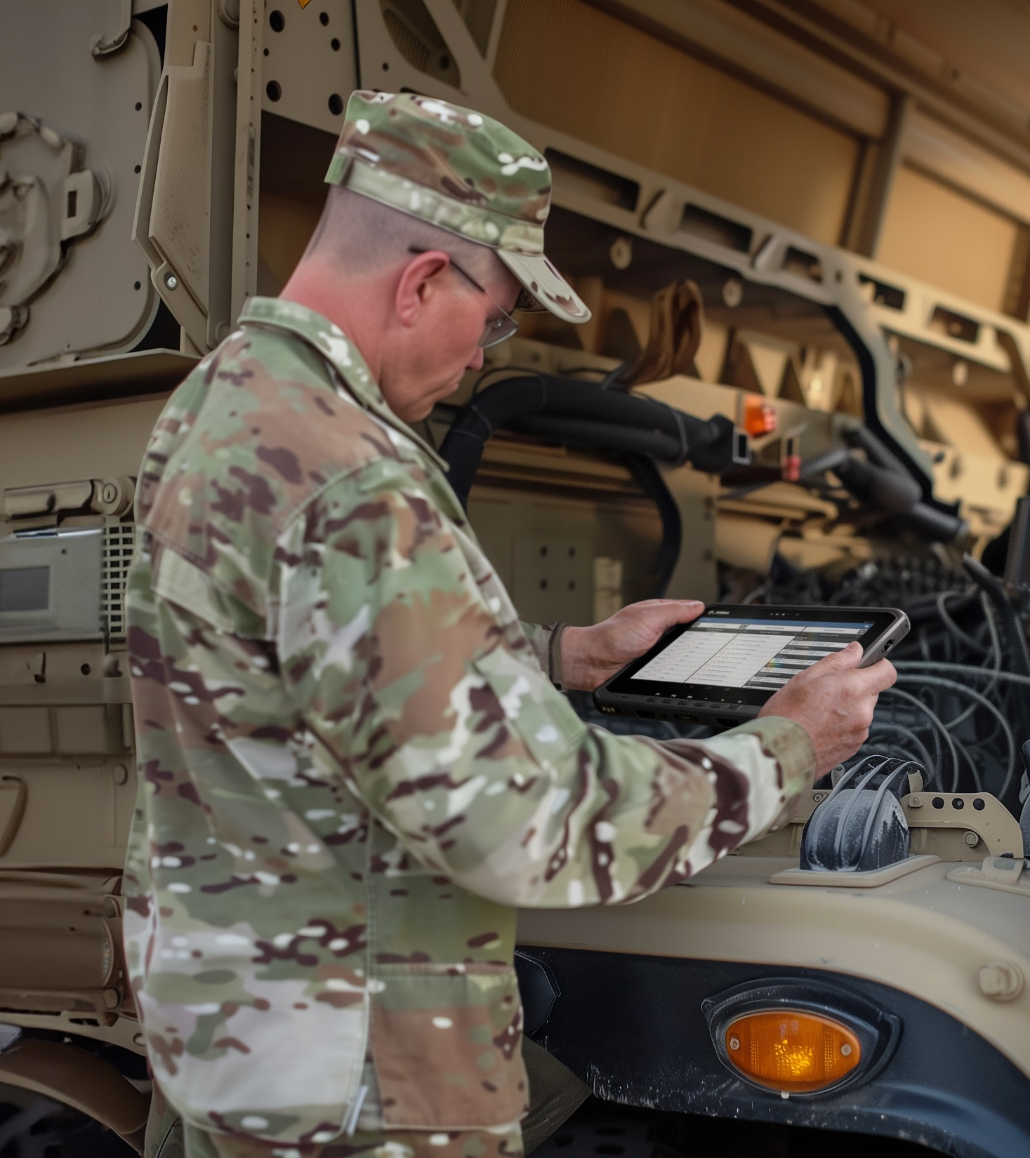




Federal Government
Meet mission-critical requirements
with better visibility
Maintenance, repair and overhaul
Track and trace assets and vehicles
Inventory management
Routing and navigation
Personnel communications
Safety inspection and compliance
Securely access critical databases

Slide 28

Retail
Delight customers from back of the
store to sales floor
Assisted selling - price/inventory checks
Line busting
POS: mobile, fixed, hybrid
Inventory management
Staff communications
Guest check-in
Restaurant wait staff / ordering
BOPIS and Curbside pickup

Slide 29

Warehouse/Yard/Ports
Manage inventory across your
entire supply chain
Warehouse and yard management
Returns processing
Cross docking
Picking
Forklift operations
Receiving
Inventory management
Loading/unloading

Slide 30

Field Mobility
Empower your team to deliver
seamless customer service in the field
Routing and dispatch
Personnel tracking
Emergency repairs
Mobile work order management
Safety inspection and compliance
Meter reading
Remote assistance

Slide 31

Healthcare
Deliver exceptional care and
elevate patient experience from
admissions to discharge
Telehealth
Patient monitoring
Patient engagement at bedside
Patient entertainment
Patient identification
Medication / Specimen collection verification
Patient self check-in
Staff management / communications
In-home caregivers

Slide 32







Your Business Demands the Best
Zebra delivers it. Purpose-built with you in mind.
Scanners
Software
Zebra Rugged Tablets + the full Zebra ecosystem
Printers
Services
Industry-leading tools
to get the job done—
no matter the conditions.
Kiosks
Supplies
Mobile Computers
Notes:
In addition to our portfolio of rugged tablets, Zebra delivers an end-to-end ecosystem of hardware, software and services for a complete solution to meet your business needs.

Slide 33






Guardian Cabinets
Optimize device storage and management
Consolidate and connect to maximize performance
Protect devices with authorized-only security
Automate workflows with software-driven management
Access support from concept to deployment, adoption to operations
Device Guardian Access Management | Guardian Cabinets | Cradle Lock | Racks | Mobile Carts
Regulate device access by authorized personnel Manage and update devices Optimize workflows Charge and monitor battery life Real-time asset and user management Enhanced reporting | Enhanced security options Software-driven security Reduction in device losses and damages Dashboard reporting Battery charge status Optimized workflows with quick access to devices | Mechanical locking for security, accountability Software-driven security Reduction in device losses and damages Battery charge status Compatible with Zebra Intelligent Racks and Cabinets | Single-sided or double-sided​ Consolidated access​ Multidevice configurations | Customer-specific use cases and projects Tailored solutions based on customers’ unique environments Accelerates workflow automation and efficiencies Primary use cases in Warehouse/Distribution Proven track record of design, deployment, integration, adoption and lifecycle management for over 15 years

Slide 34

Zebra DNA™ for Mobile Computers
Experience a new breed of mobility
What is Zebra DNA for Mobile Computers?
It is a suite of enterprise solutions designed to help maximize mobile user productivity and minimize IT complexities over the lifespan of a Zebra computer, tablet or wearable device.
Zebra DNA for Mobile Computers offers secure solutions to help set up, secure, manage and optimize every stage of your devices' lifecycle. Simplifying device lifecycle management and the user experience, Zebra DNA for Mobile Computers helps achieve and accelerate greater business outcomes, lowering total cost of ownership, helping to meet your unique business needs.
ZEBRA TECHNOLOGIES
For more information about Zebra's value add Mobility DNA solutions, visit www.zebra.com/mobilitydna

Slide 35




Zebra DNA for Mobile Computers
Set Up. Secure. Manage. Optimize
From handhelds and tablets to wearables and vehicle-mounted computers, Zebra’s broad portfolio of robust enterprise hardware, driven by our powerful Zebra DNA in-device software, is designed to ensure continuous visibility, maximum uptime and the flexibility to adapt to changing workflows with ease and efficiency.
See these important outcomes in action:
Empower retail workers to provide an excellent shopper experience with mobile devices that help streamline processes, get real-time inventory visibility and optimize store and online workflows
Improve patient identification, safety and care from admission to discharge. Have immediate access to a patient’s medical data and get more time for clinician bedside care
Maximize productivity and deliver flawless fulfillment in even the most challenging warehouse environments with powerful vehicle-mounted computers
ZEBRA TECHNOLOGIES

Slide 36




Maximize Your ROI With Zebra Services
Embarking on a technology transformation can be complex and costly. Zebra Services is here to help you minimize risks and accelerate your journey. Our robust portfolio ensures your Zebra devices, software and solutions are expertly built, efficiently managed and quickly adopted by your team. Trust us to streamline your launch and enhance the value of your investment¹.
1. Service availability, Service feature and/or repair turn-around time may differ by country. Please contact your Zebra sales representative for details.

Slide 37


Standard Zebra OneCare Maintenance Plans for Tablets
Choose the Plan that Meets Your Business Urgency
Enhancements for your Maintenance Plan
Battery Plans
Ensure your devices remain operational and efficient by providing battery replacements for those unable to maintain an 80% charge, minimizing downtime and maximizing productivity. Choose from three levels of coverage to meet your specific needs.
Fasttrack (NA, UK, Ireland)
Simplify device replacement. A trained courier delivers a ready-to-use replacement device and collects the faulty one, minimizing logistics and admin costs.
Enhanced Shipping Logistics
Expedited Collections: Use pre-paid labels and the Zebra RMA portal for easy carrier pickup scheduling.
Expedited 2-Way Shipping: Benefit from Express shipping both to and from Zebra’s Repair Center, ensuring quick turnaround times.
All three plans benefit from OS updates, LifeGuard™ security and efficient repair status management.
Add on enhancements to enjoy streamlined commissioning, battery maintenance and expedited shipping for seamless, uninterrupted operations.
*Currently available for Zebra mobile computers only

Slide 38












Optimize your operations with
Zebra VisibilityIQ Foresight™
Turn Reactive Actions
Into Proactive
Data-Driven Decisions
Prevent downtime, improve efficiency and bring costs down with predictive insights and historical trends for your mobile computers and batteries
Ensure devices
are ready and available for the workday
Forecast seasonal demands with
utilization trends
View device inventory, utilization, location
and performance
Access critical data on battery statistics to
prevent downtime
Avoid workflow disruptions by discovering root of issues
Keep teams connected
with threshold notifications
Forgo guesswork
for data-driven decisions
Track device
repair cases
and status
Predict issues before they impact productivity

Slide 39








Innovate Better with Professional Services
Follow the right plan to accelerate outcomes
Unlock Your Productivity Potential
Make the most of your workforce, assets and data with the right tech stack deployed strategically by the experts—and watch your operation take off.
Uncover new sources of transformation
with new ways to integrate, adopt and maximize data solutions to meet your changing business priorities.
Deliver rapid ROI
by addressing your specific challenges head-on with a tailor-made plan developed by a team of dedicated experts.
Accelerate business outcomes
by shortening the ramp to revenue with an industry leader poised to help you quickly translate your data into intelligent action that enables reduction in labor and increase in accurate inventory visibility with minimal risk and faster pay off.

Slide 40
Thank you!
For more information, please visit, www.zebra.com/tablets
ZEBRA and the stylized Zebra head are trademarks of Zebra Technologies Corp., registered in many
jurisdictions worldwide. Android is a trademark of Google LLC. The Bluetooth® word mark and logos
are registered trademarks owned by Bluetooth SIG, Inc. and any use of such marks by Zebra is under license. Wi-Fi™ is a trademark of Wi-Fi Alliance®. All other trademarks are the property of
their respective owners. ©2024 Zebra Technologies Corp. and/or its affiliates. 12/19/2024

